Slide 1

GATE + College
Understanding GATE, Building Strong Foundations & Managing GATE with College
Saumya Pathak
[DDU/IT]
Mobile no: 9016639757
Linkedin: Saumya Pathak

Slide 2
What is GATE?
■
Graduate Aptitude Test in Engineering.
■
It is a prestigious national-level examination.
■
It comprehensively assesses your understanding of undergraduate-level subjects in your selected technical paper.
■
It includes a dedicated section for General Aptitude.
■
It acts as a primary gateway for higher studies and various specialized career opportunities.

Slide 3

Who Can Appear for GATE?
Current Undergraduate Students
Graduates
Candidates currently studying in the 3rd year or higher of any undergraduate degree program (B.Tech / B.E. / B.Sc / etc.) are eligible to appear.
Candidates who have already completed any government-approved degree program in Engineering, Technology, Architecture, Science, Commerce, or Arts.
Important Note: Eligibility rules can be updated. Always verify the latest official criteria from the current year's GATE website.

Slide 4






GATE at a Glance
65 Questions
100 Marks
Weightage
Mixed format including Multiple Choice (MCQ), Multiple Select (MSQ), and Numerical Answer Type (NAT).
Total score is out of 100, requiring a balance of accuracy and broad syllabus coverage.
15 marks of General Aptitude.
Remaining 85 marks are dedicated to the selected subject paper.
Exact question distribution can vary by paper/year. Refer to the official GATE brochure for the current pattern.

Slide 5
Why Should You Consider GATE?
■
Higher Studies: Pursue M.Tech/M.E. and postgraduate education.
■
Premier Institutes: Admission opportunities in top-tier colleges (IITs, NITs, IISc).
■
Research: Open doors to advanced research opportunities.
■
Career Prospects: Certain PSU recruitment opportunities (where applicable).
■
Technical Strength: Builds an incredibly strong technical and conceptual foundation for any engineering career.

Slide 6




GATE is More Than an Exam
GATE preparation forces you to move beyond surface-level learning.
1. Exam Focus
2. Conceptual Clarity
3. Problem Solving
4. Tech Foundation
Provides a structured goal.
Requires deep understanding.
Builds analytical ability.
Creates a lifelong asset.
■
It builds revision discipline.
■
It ensures a rigorous understanding of core computer science subjects.

Slide 7

Why Start Early?
"Start early — not to study more, but to study better."
The Benefits of Time
Strategic Advantages
■
More time to deeply understand core concepts.
■
More time to practice Previous Year Questions (PYQs) and revise.
■
Significantly less pressure in 6th/7th semesters.
■
Better opportunity to identify and fix weak areas early.
■
Allows for gradual, stress-free preparation.
■
Builds a stronger foundation for college placements as well.

Slide 8
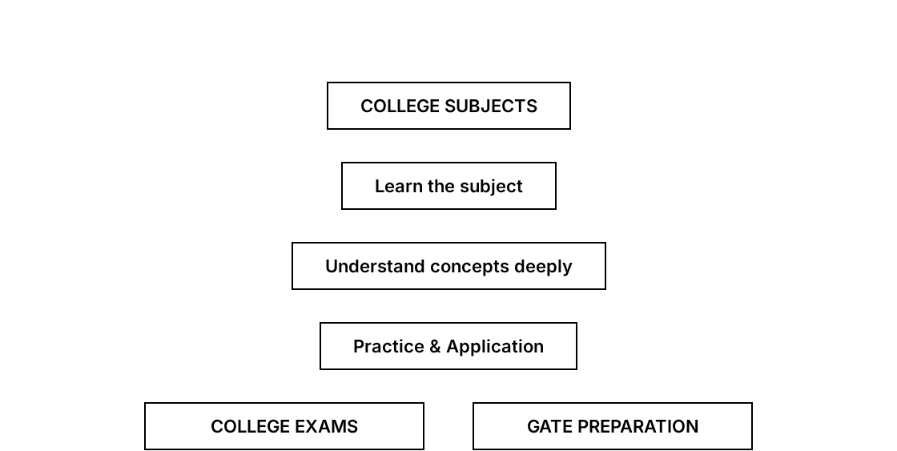
GATE + College: The Connection
College preparation and GATE preparation do not always have to be two separate workloads.

Slide 9


One Subject → Two Benefits
Example: Operating Systems
College Academics
GATE Preparation
■
Learn what processes are.
■
Understand these concepts deeply.
■
Study CPU scheduling algorithms.
■
Practice numerical and conceptual questions on scheduling/memory.
■
Understand process synchronization.
■
Solve GATE PYQs on the topic.
■
Learn memory management theories.
■
Revise and master the logic.
Conclusion: One subject can perfectly support both your semester GPA and your GATE foundation.

Slide 10

GATE CS Core Subjects
These subjects will appear throughout your B.Tech journey. This creates an opportunity to integrate your preparation.
Engineering Mathematics
Discrete Mathematics
Prog. & Data Structures
Algorithms
Digital Logic
Comp. Org. & Architecture
Operating Systems
Database Management Sys.
Computer Networks
Theory of Computation
Compiler Design

Slide 11
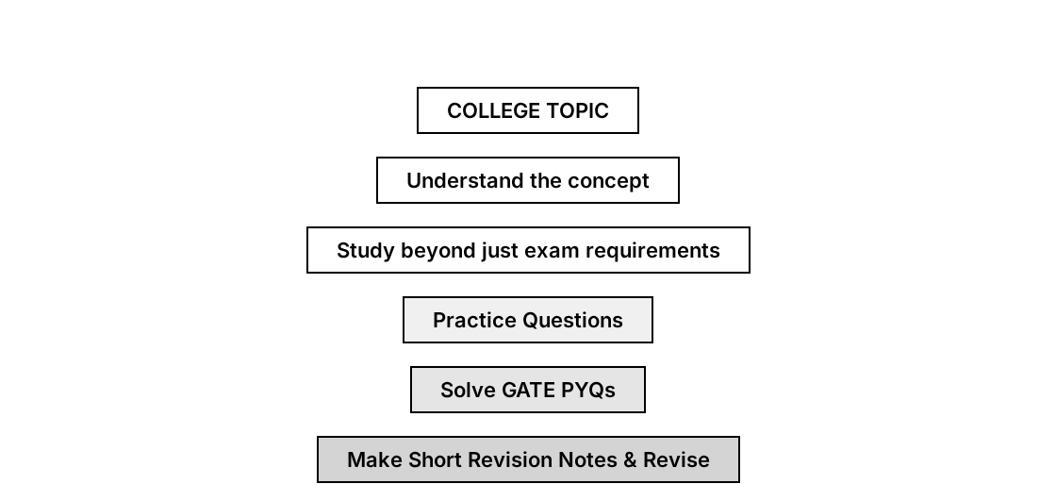
How College Becomes Your Foundation
Don't study only to pass the semester. Build understanding that stays with you.

Slide 12
Managing GATE + College
■
Academics First: College academics remain important. Prioritize current semester subjects.
■
Overlap: Use overlapping subjects to build your GATE foundation.
■
Practice > Passive Learning: Solve questions instead of only watching lectures.
■
Minimalism: Avoid unnecessary resource collection. Stick to standard books/materials.
■
Consistency: Maintain regular revision and consistency rather than extreme study hours. Plan weekly, not minutely.

Slide 13
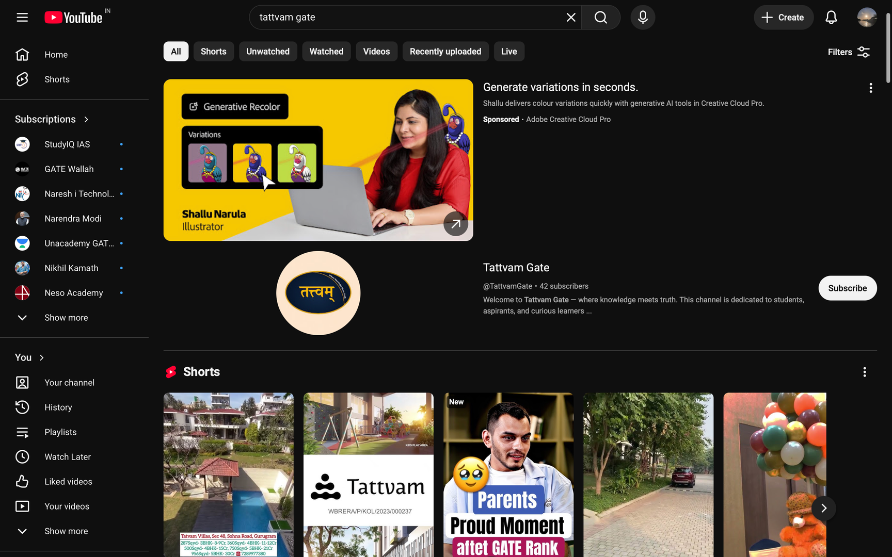

Youtube: Tattvam Gate

